Slide 1
Travaux Pratiques
MQTT, Data Analytics and Visualisation

Slide 2
Environnement
OS: Windows, Mac, Appliance Vmware/Vbox (Linux Ubuntu Server)
Python
Libraires Python : MQTT, JSON, XMPP, HTTP
Broker MQTT: Mosquitto (OK)
Broker AMQP: Kafka

Slide 3
MQTT

Slide 4
Test 1: PubSub MQTT en Python
Device Publisher Python
MQTT
Broker MQTT
MQTT
Consumer (Subscriber Python)
Convert Random Values into JSON Object

Slide 5
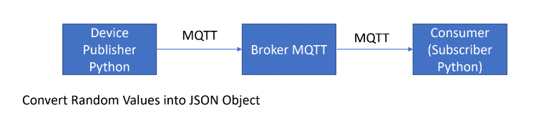
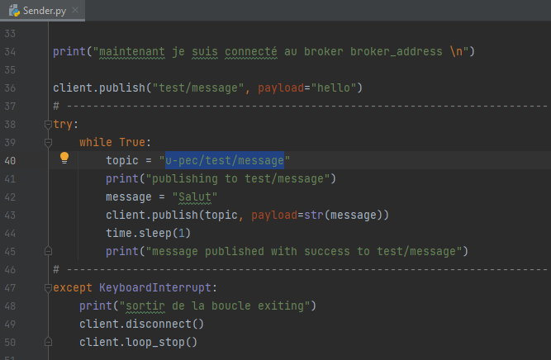
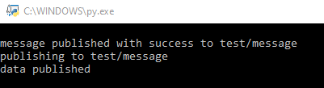
Test 1: PubSub MQTT en Python
Après l’installation de la Librairie Paho-MQTT de la protocole MQTT.

Slide 6
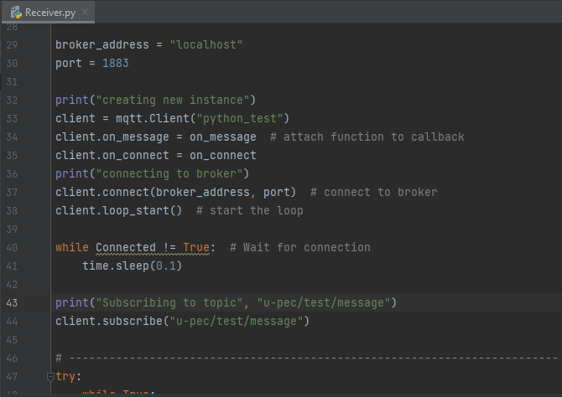

Test 1: PubSub MQTT en Python

Slide 7
Test 2: PubSub MQTT en Python
Consumer (Subscriber Python)
Device Publisher Python
MQTT
Broker MQTT
MQTT
Consumer (Subscriber Python)
Convert Random Values into JSON Object
Consumer (Subscriber Python)

Slide 8
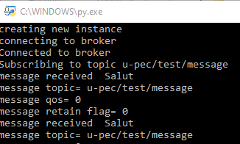
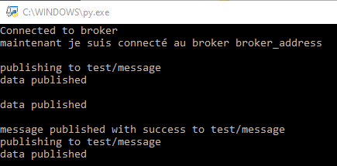

Slide 9

Publisher of QR Code
!pip install opencv-python
import glob import cv2 import pandas as pd import pathlib
def read_qr_code(filename):
"""Read an image and read the QR code.
Args:
filename (string): Path to file Returns:
qr (string): Value from QR code
"""
try:
img = cv2.imread(filename)
detect = cv2.QRCodeDetector() value, points, straight_qrcode = detect.detectAndDecode(img)
return value
except:
return

Slide 10
Test 3: PubSub MQTT en Python
3 QR Code READERS simulators
Consumer (Subscriber Python)
Device Publisher Python
Device Publisher Python
MQTT
Broker MQTT
MQTT
Consumer (Subscriber Python)
Device Publisher Python
Consumer (Subscriber Python)
Convert Random Values into JSON Object

Slide 12
Test 4: PubSub MQTT en Python
Device Publisher Python
MQTT
Broker MQTT
MQTT
Consumer (Subscriber Python)
Convert CSV line to JSON Object
Display Items
CSV (timestamp)
log_temp.csv
Temperature.csv

Slide 13
Test 5: PubSub MQTT en Python
Device Publisher Python
MQTT
Broker MQTT
MQTT
Consumer (Subscriber Python)
Convert CSV line to XML Object
Display Items
CSV (timestamp)
log_temp.csv
Temperature.csv

Slide 14
Test 6: PubSub MQTT en Python
Consumer (Subscriber Python)
Device Publisher Python
Device Publisher Python
MQTT
Broker MQTT
MQTT
Consumer (Subscriber Python)
Device Publisher Python
Consumer (Subscriber Python)
CSV (timestamp)
Convert CSV line to JSON Object
log_temp.csv
Temperature.csv

Slide 15
Test 7: PubSub MQTT en Python
Consumer (Subscriber Python)
Device Publisher Python
Device Publisher Python
MQTT
Broker MQTT
MQTT
Consumer (Subscriber Python)
Device Publisher Python
Consumer (Subscriber Python)
CSV (timestamp)
Mongodb
Convert CSV line to JSON Object
log_temp.csv
Temperature.csv

Slide 16
Test 8: PubSub MQTT Scrapper from Twitter
Device Publisher Python
MQTT
Broker MQTT
MQTT
Consumer (Subscriber Python)
API Twitter
Mongodb
Servers Twitter

Slide 17
KAFKA

Slide 18
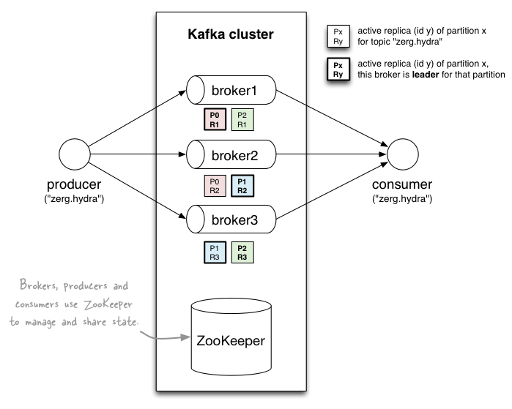
A first look

Slide 19
Topics
Topic: feed name to which messages are published
Example: “zerg.hydra”
Kafka prunes “head” based on age or max size or “key”
Producer A1
Kafka topic
Producer A2
…
…
new
Producer An
Older msgs
Newer msgs
Producers always append to “tail”
(think: append to a file)
Broker(s)

Slide 20
Topics
Consumer group C1
Consumers use an “offset pointer” to
track/control their read progress
(and decide the pace of consumption)
Consumer group C2
Producer A1
Producer A2
…
…
new
Producer An
Older msgs
Newer msgs
Producers always append to “tail”
(think: append to a file)
Broker(s)

Slide 21
Kafka adoption and use cases
LinkedIn: activity streams, operational metrics, data bus
400 nodes, 18k topics, 220B msg/day (peak 3.2M msg/s), May 2014
Netflix: real-time monitoring and event processing
Twitter: as part of their Storm real-time data pipelines
Spotify: log delivery (from 4h down to 10s), Hadoop
Loggly: log collection and processing
Mozilla: telemetry data
Airbnb, Cisco, Gnip, InfoChimps, Ooyala, Square, Uber, …

Slide 22
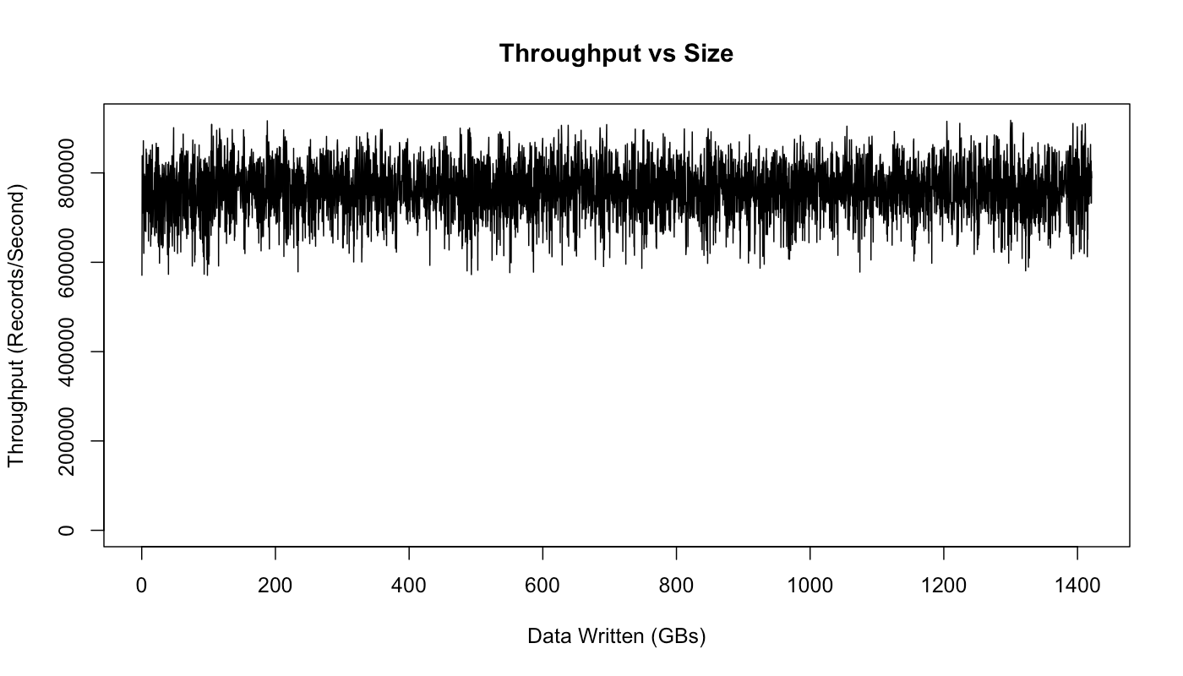
How fast is Kafka?
“Up to 2 million writes/sec on 3 cheap machines”
Using 3 producers on 3 different machines, 3x async replication
Only 1 producer/machine because NIC already saturated
Sustained throughput as stored data grows
Slightly different test config than 2M writes/sec above.

Slide 23
Why is Kafka so fast?
Fast writes:
While Kafka persists all data to disk, essentially all writes go to the page cache of OS, i.e. RAM.
Fast reads:
Very efficient to transfer data from page cache to a network socket
Linux: sendfile() system call
Combination of the two = fast Kafka!
Example (Operations): On a Kafka cluster where the consumers are mostly caught up you will see no read activity on the disks as they will be serving data entirely from cache.

Slide 24
Installation couple Kafka-Zookeeper
Apache Kafka® utilise ZooKeeper pour stocker les métadonnées persistantes du cluster et est un composant critique du déploiement de la plateforme.

Slide 25
Kafka Quickstart
Steps for downloading Kafka, starting a server, and creating a console-based consumer/producer
Requires ZooKeeper to be installed and running
https://kafka.apache.org/documentation.html#quickstart
https://github.com/adamjshook/hadoop-demos/tree/master/kafka

Slide 26
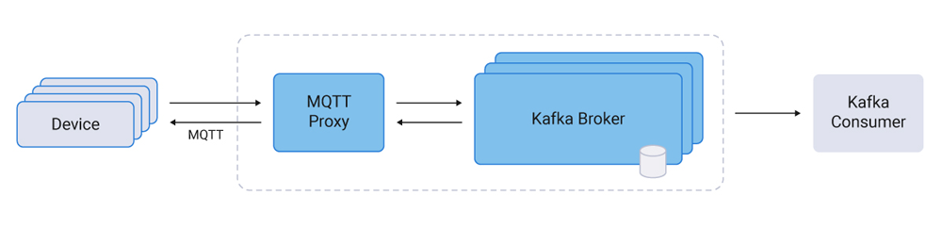
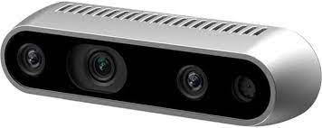
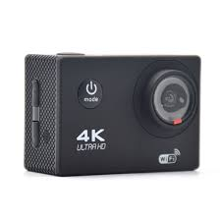
Test 9: Connecteurs(*) KAFKA
1
Producer KAFKA (Publisher Python)
HD1
HD2
2
Producer KAFKA (Publisher Python)

Slide 27
Test 10: Connecteurs(*) KAFKA
1
Producer KAFKA (Publisher Python)
Mongodb
HD1
5
6
HD2
2
3
Producer KAFKA (Publisher Python)
Consumer KAFKA (Subscriber Python)

Slide 28
Test 11: Connecteurs(*) KAFKA
4
Connector Log File, CSV
1
Producer KAFKA (Publisher Python)
Mongodb
5
6
2
3
Producer KAFKA (Publisher Python)
Consumer KAFKA (Subscriber Python)

Slide 29
Test 12: Connecteurs(*) KAFKA
4
Connector Log File, CSV
1
Producer KAFKA (Publisher Python)
Mongodb
5
6
2
3
Producer KAFKA (Publisher Python)
Consumer KAFKA (Subscriber Python)

Slide 30
Test 13: Connecteurs(*) KAFKA
4
Connector Log File, CSV
1
Mongodb
API Twitter
5
6
7
Servers Twitter
2
3
Producer KAFKA (Publisher Python)
Consumer KAFKA (Subscriber Python)

Slide 31
Test 14: Connecteurs(*) KAFKA
4
Connector Log File, CSV
1
Mongodb
5
6
2
3
Producer KAFKA (Publisher Python)
Consumer KAFKA (Subscriber Python)
API Twitter
Servers Twitter
8

Slide 32
Test 15: Connecteurs(*) KAFKA
4
Connector Log File, CSV
ElasticSearch
1
9
Mongodb
5
6
2
3
Producer KAFKA (Publisher Python)
Consumer KAFKA (Subscriber Python)
API Twitter
Servers Twitter
8

Slide 33
Intégration Kafka, NoSQL, Vos Python Programs avec Nifi
Objectif
éviter d'écrire de longs codes.
Administrer l'ensemble des pipelines de flux de données entre les différents composants via NiFi sur un seul écran.
Kafka: Apache Nifi peut fonctionner aussi bien comme consommateur que comme producteur.

Slide 34
Test 16: Connecteurs(*) KAFKA
1
Producer KAFKA (Publisher Python)
Mongodb
5
6
2
3
Connector CSV file (IRIS)
ML program IRIS (Features extraction and Classification in Python)

Slide 35
Test 17: Connecteurs(*) KAFKA
1
4
Producer KAFKA (Publisher Python)
Mongodb
ML program IRIS2 (Classification in Python)
5
6
Pipe Linux
2
3
Connector CSV file (IRIS)
ML program IRIS1 (Features extraction in Python)

Slide 36
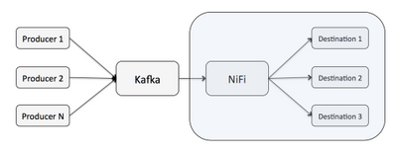
Test 18: Intégration Kafka, NoSQL, Vos Python Programs avec Nifi
Pipe Nifi
ML program IRIS1 (Features extraction in Python)
ML program IRIS2 (Classification in Python)
Connector CSV file (IRIS)
Mongodb

Slide 37
Test 19: Connecteurs(*) KAFKA
https://archive.ics.uci.edu/ml/datasets/Smartphone+Dataset+for+Human+Activity+Recognition+%28HAR%29+in+Ambient+Assisted+Living+%28AAL%29
1
Producer KAFKA (Publisher Python)
Mongodb
5
6
2
3
Connector CSV file (Smartphone AccelerometerData)
ML program ADL (Features extraction, Classification in Python)

Slide 38
Test 20: Intégration Kafka, NoSQL, Vos Python Programs avec Nifi
Pipe Nifi
ML program ADL1 (Features extraction in Python)
ML program ADL2 (Classification in Python)
Connector CSV file (Smartphone AccelerometerData)
https://archive.ics.uci.edu/ml/datasets/Smartphone+Dataset+for+Human+Activity+Recognition+%28HAR%29+in+Ambient+Assisted+Living+%28AAL%29

Slide 39
Test 21: Intégration Kafka, NoSQL, Vos Python Programs avec Nifi
Pipe Nifi
ML program ADL1 (Features extraction in Python)
ML program ADL2 (Classification in Python)
Connector CSV file (Smartphone AccelerometerData)
Mongodb
https://archive.ics.uci.edu/ml/datasets/Smartphone+Dataset+for+Human+Activity+Recognition+%28HAR%29+in+Ambient+Assisted+Living+%28AAL%29

Slide 40
Test 22: Intégration Kafka, NoSQL, Vos Python Programs avec Nifi
ML program in Python
ML program in Python
Scrapper Twitter 1
ML program in Python
Scrapper Twitter 2
ElasticSearch
Scrapper Wikihow
Mongodb

Slide 41
Test 23: Intégration Kafka, NoSQL, Vos Python Programs avec Nifi
Data Visualisation
Kibana
ML program in Python
ML program in Python
Scrapper Twitter 1
ML program in Python
Scrapper Twitter 2
ElasticSearch
Scrapper Wikihow
Mongodb

